Slide 1
From Bin to Win:
Writing better funding proposals
David Burgess
Reject
Fund

Slide 2
What you think it’s like:

Slide 3
What it’s ACTUALLY like:

Slide 4
Time is not on your side

Slide 5
What can you do about it?
Short - only say what you need to say
Short, simple sentences
Top and Tail with key points
Highlight key points with bold text, headings & image captions
Don’t rely on attachments or external links
Get your proposal in early!

Slide 6
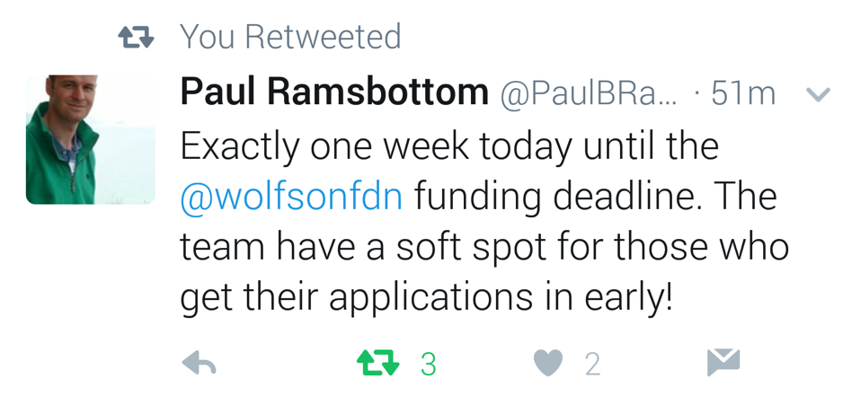

Slide 8
Make it easy to read
Protect the White Space!
Use short sentences and simple language
Use headings, pictures, bullet points
Use left-justified text

Slide 9
Most proposals answer the wrong question

Slide 10
What do Trusts need to know?
How does this meet our aims?
What is the need for this work?
How much money do they need? And when?
What impact will our gift have? Value for money?
What are the risks?
Why should we support this over other projects?

Slide 11
Ask not what this Trust can do for you…
…but rather what you can do for this Trust

Slide 12
What can you do about it?
Be picky about who you apply to
Make sure you fully understand the funder’s aims
Be explicit about how your project will help the funder meet those aims
Quantify the impact their grant will have against those aims
Use the funder’s language…but show you know what it means/how it is relevant to you

Slide 13
Are they the right funder? Are you the right charity?
Motivation
Capacity
Reach

Slide 14
Motivation
Closeness to stated aims & objectives
Favoured projects – Core? Capital?
Priority areas/Strategic programmes
Funded similar things
Future Plans
Signs of flexibility

Slide 15
Capacity to Give
Average Grant
Upper and lower limits
Amount to new projects
Where does the money come from?
Financial trends – more or less money?

Slide 16
In your reach?
Eligibility and exclusions
Key people
Timeframes
Rules and Processes

Slide 17
The Muggle Question:
What do we need funding for?
Notes:
For Core?
For Store Project?

Slide 18
The Better Question:
Why?

Slide 19
Most proposals are gobbledygook

Slide 20
The Curse of Knowledge
“Once we know something, we find it hard to imagine what it was like not to know it.
Our knowledge has “cursed” us. And it becomes difficult for us to share our knowledge with others, because we can’t readily re-create our listeners’ state of mind”.
Chip and Dan Heath, Made to Stick

Slide 22
What can you do about it?
Assume they know nothing – paint them a picture
Get an “outsider” to review it
Look for connections with things your reader will know / have experienced
Avoid jargon - and remember we don’t always know what’s jargon

Slide 23
Most applications are painfully boring to read

Slide 24
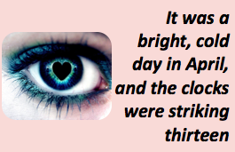
Be Passionate!
Tell Stories!
Be Gripping!
Be Different!

Slide 25
Sometimes there is nothing else you can do

Slide 26
Structuring your proposal

Slide 27
Section 1 – Summary
Purpose: To control messaging to trustees. To get most important info across when most engaged.
2-3 sentences
Who are you applying to?
How do you match their aims?
How much are you asking for?
What will the funding be used for?

Slide 28
Section 2 – Who are you?
Purpose: To build trust and confidence that you can be trusted
Brief history of organisation
Summary of successes
Anything that demonstrates why you are the right org to deliver this project
Any other partners involved
Previous experience of delivering similar projects

Slide 29
Section 3 – What’s the Need?
Purpose: To show the problem that you are trying to address
What is the problem you are seeking to address?
Why does this problem urgently need to be solved?
What evidence do you have about the scale, impact & current trend of the problem?
Who is negatively impacted by the problem?

Slide 30
Section 4 – What are you doing?
Purpose: To show how the work you are proposing will address the problem
What will you deliver to solve the problem?
Paint a picture! Bring it to life!
How will this help?

Slide 31
Section 5 – How will you know if it has worked?
Purpose: To show how you will evaluate the project and share your learning with others
How will you monitor during the project?
How will you know if your intervention has worked?
How will you evaluate your approach?
How will you share any lessons with the wider sector?

Slide 32
Section 6 – What comes next?
Purpose: To show you have considered what will happen to project/participants when funding ends
Will the project continue beyond this grant?
If so, how will you pay for it?
If not, what happens to participants?

Slide 33
Section 7 – What is the current financial position?
Purpose: To explain how this grant fits into the total project budget
What is the total cost?
How much has already been raised? From where?
What is the current shortfall?
Who else has been approached?
What are your plans for raising the rest?

Slide 34
Section 8 – Final Ask
Purpose: To link everything back to the Trust and what you are asking them to do
How much are you asking for?
What impact will it have?
How will it fit with the trust’s aims?

Slide 35
Proposal Structure Recap
Summary
Introduction
Problem
Solution
Evaluation
Exit Strategy
Budget
Final Ask

Slide 36
Make it easy to (skim) read
Use short sentences
Keep to 2 pages where possible – cut, cut, cut
Use Left-aligned text
Use bold text and image captions
Protect the White space
Use simple language – no jargon!

Slide 37
Make it easy to process
Include a summary
Follow all of the guidelines
Consider the photocopier!
Avoid sending large parcels/recorded delivery
Get your proposal in ahead of the deadline

Slide 38
Make it easy to fund
Make it about the Trust and their aims
Reflect their words and phrases
Consider using quotes, case studies and stories
Be passionate - Paint a picture & help them to visualise it

Slide 40
David Burgess
David.Burgess@ApolloFundraising.com
www.ApolloFundraising.com
@DavidBurgessFR
@Apollo_FR_

